Slide 1
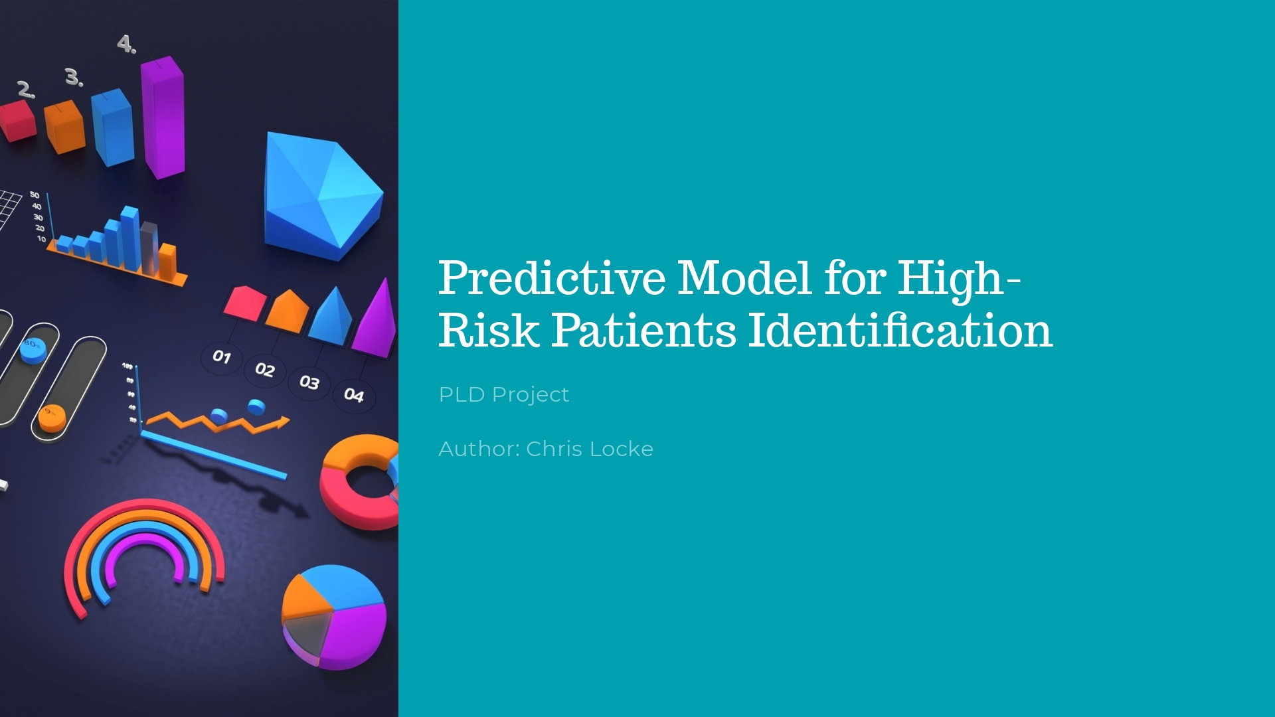

Slide 2
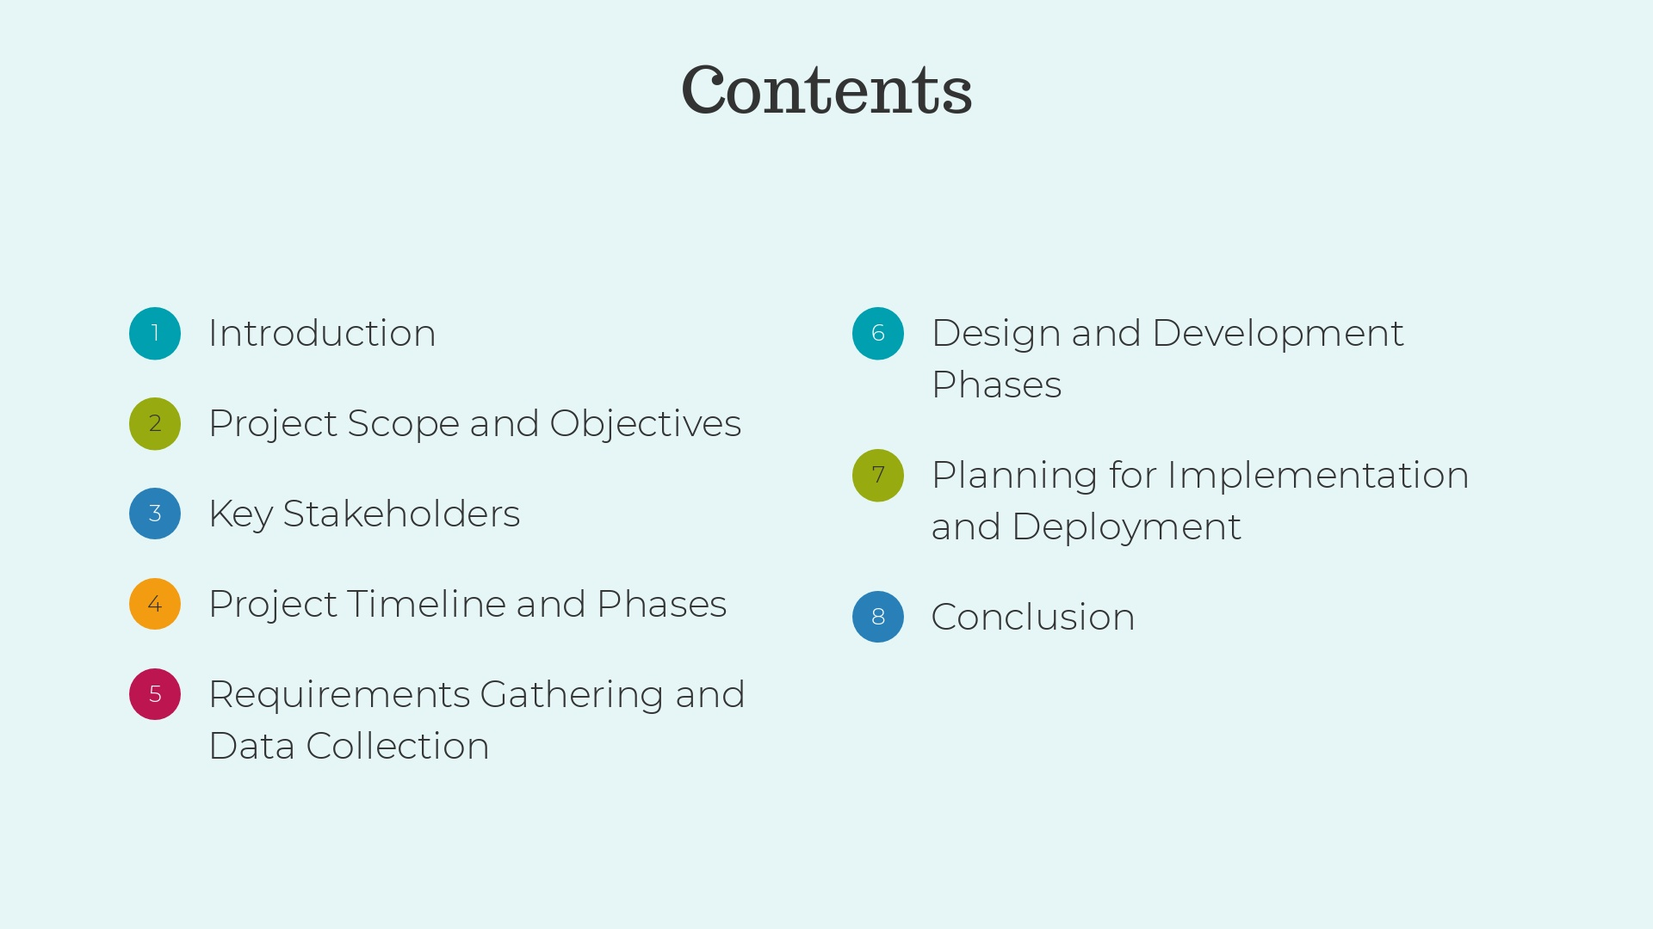

Slide 3
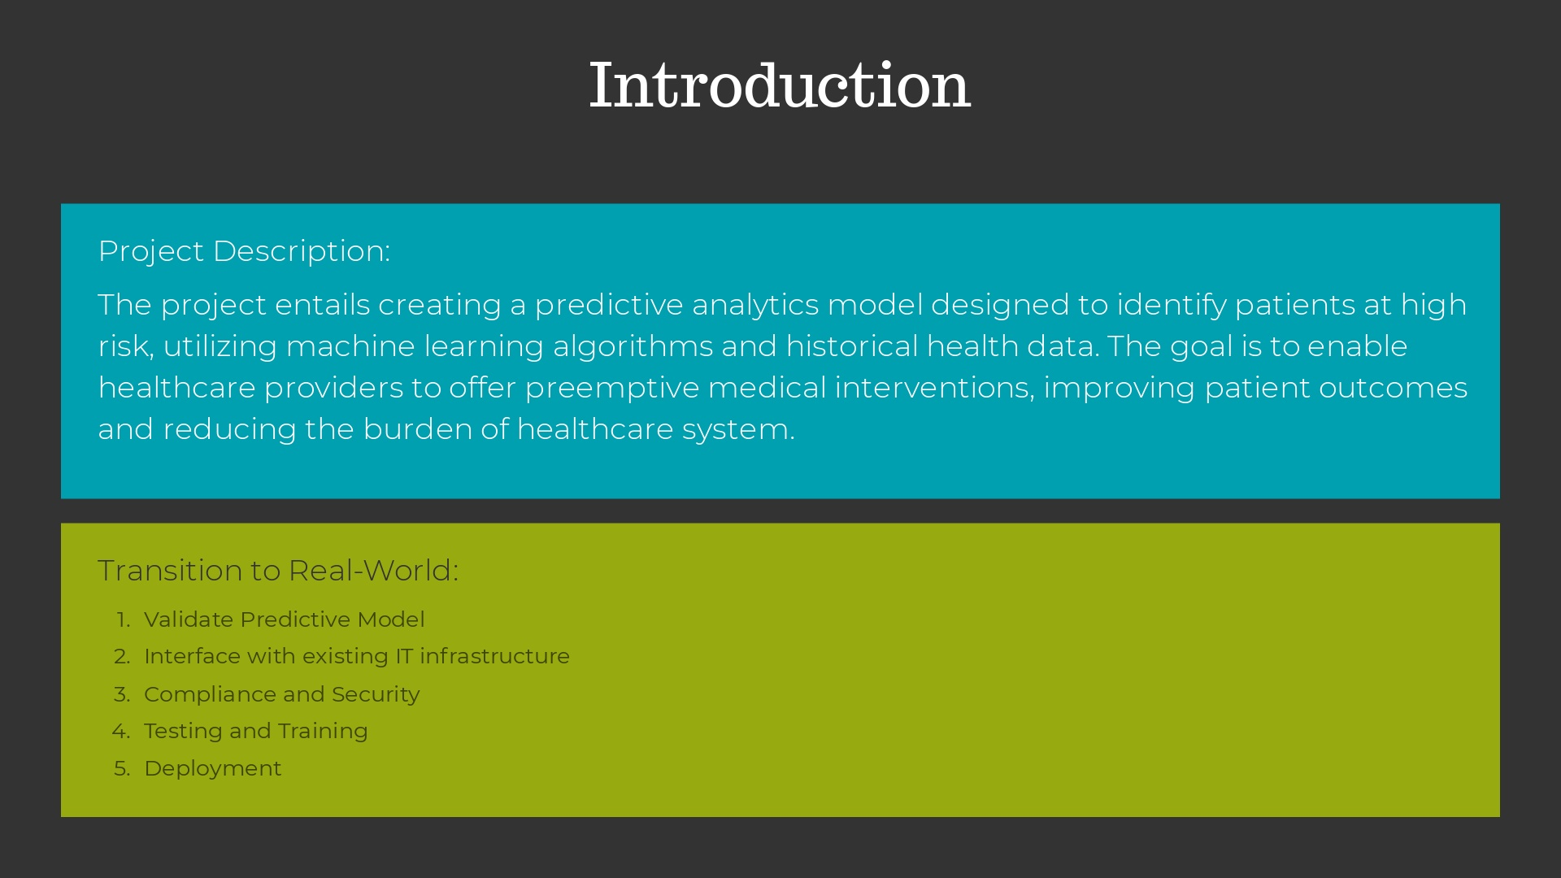
Notes:
Project Goals: 1. Develop a Predictive Analytics Model: Construct a robust model using machine learning algorithms to predict patients at high risk based on historical health data. 2. Improve Patient Outcomes: Utilize the predictive insights provided by the model to enable healthcare providers to implement preemptive medical interventions, thus enhancing patient care and improving health outcomes. 3. Reduce Healthcare System Burden: By identifying high-risk patients early and managing their care proactively, aim to decrease the frequency and necessity of emergency interventions and hospital admissions, thereby reducing the overall strain on healthcare resources. 4. Enhance Decision-Making: Provide healthcare professionals with a powerful tool that supports and enhances their decision-making processes, ensuring more accurate and timely medical interventions. 5. Documentation and Case Study: Produce comprehensive documentation of the model's development process and a detailed case study on its application, serving as a reference and framework for future projects.

Slide 4
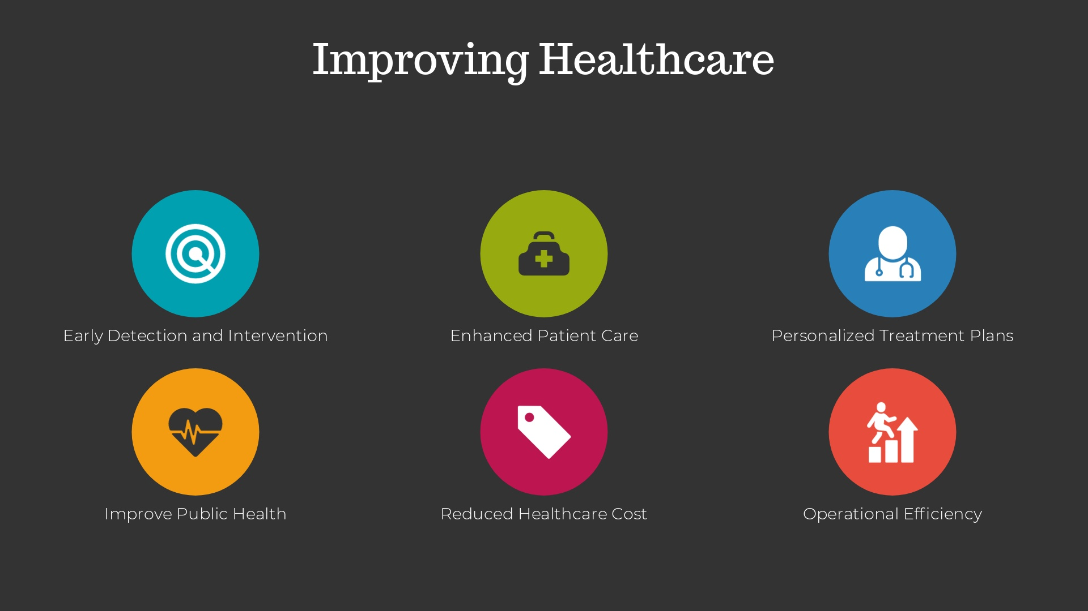
Notes:
Improving Healthcare 1. Early Detection and Intervention · Predictive models analyze patterns in health data to identify risk factors and symptoms sooner, enabling healthcare providers to intervene earlier, potentially before the patient even experiences significant symptoms. 2. Enhanced Patient Care · By providing accurate predictions and insights, predictive models support clinicians in making more informed decisions, leading to higher quality care and better patient outcomes. 3. Personalized Treatment Plans · Predictive analytics can factor in individual patient data such as genetics, lifestyle, and previous health records, allowing for treatment plans that are tailored specifically to each patient’s unique health profile. 4. Improve Public Health · These models can analyze data across populations to predict disease outbreaks, track health trends, and inform public health policies, thereby enhancing the health of the community as a whole. 5. Reduced Healthcare Costs · By enabling early intervention and personalized treatment, predictive models help prevent costly emergency care situations and reduce the need for expensive, reactive medical treatments. 6. Operational Efficiency · Predictive models streamline various healthcare processes, such as patient triage, resource allocation, and staff scheduling, leading to improved efficiency and better utilization of healthcare resources.

Slide 5
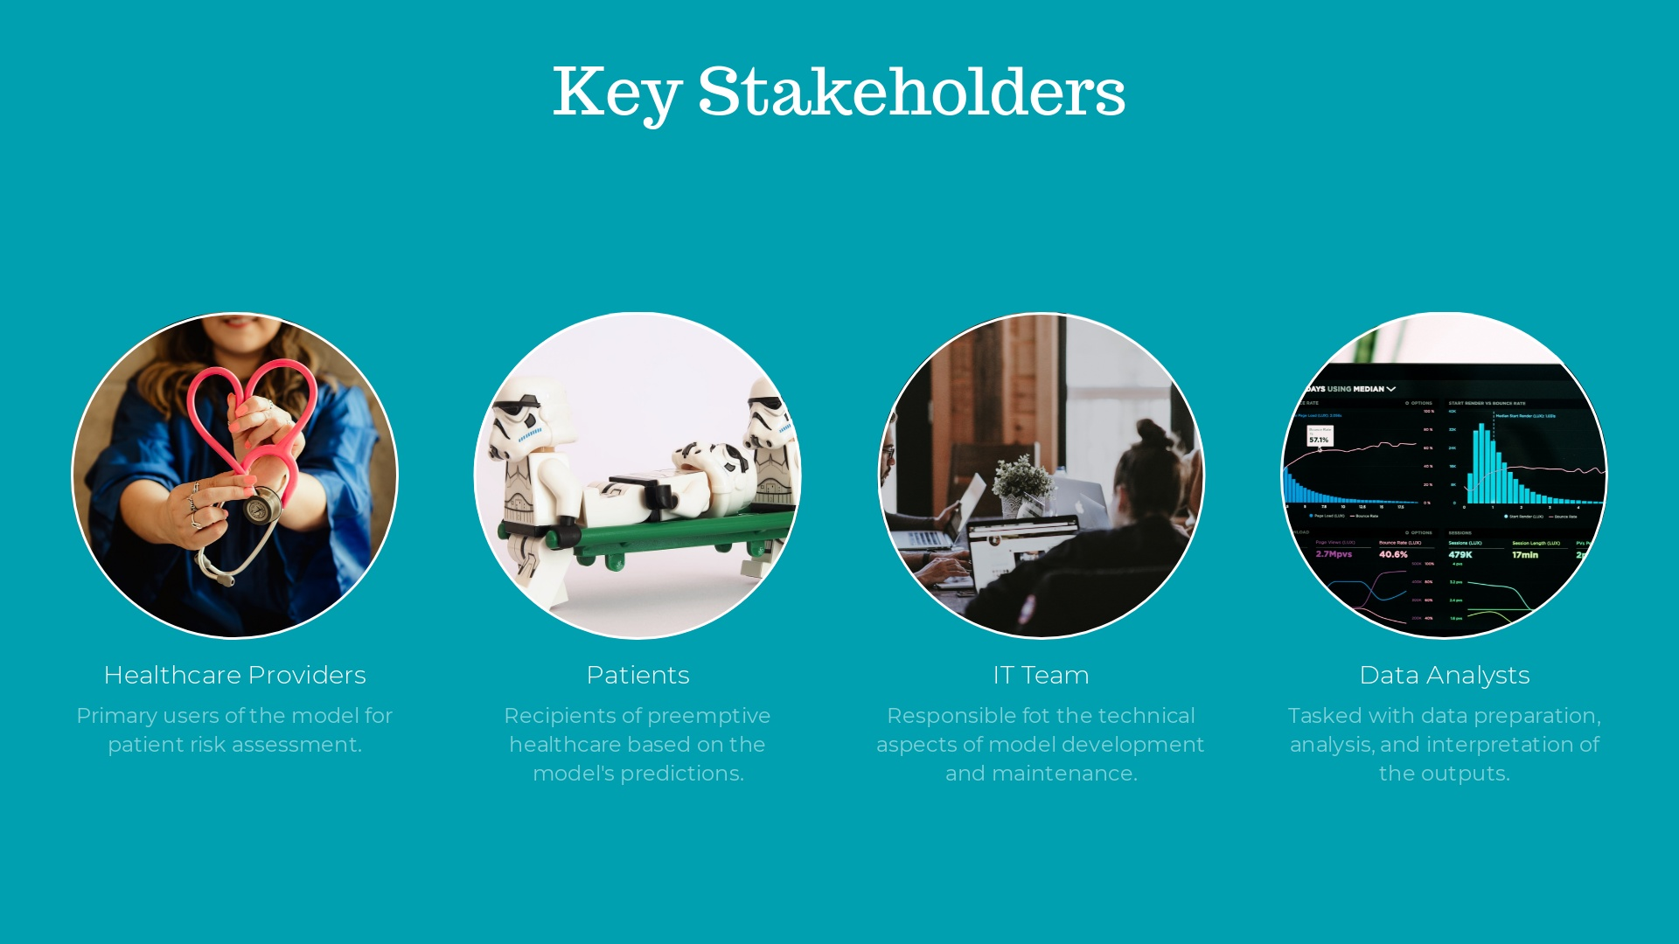

Slide 6
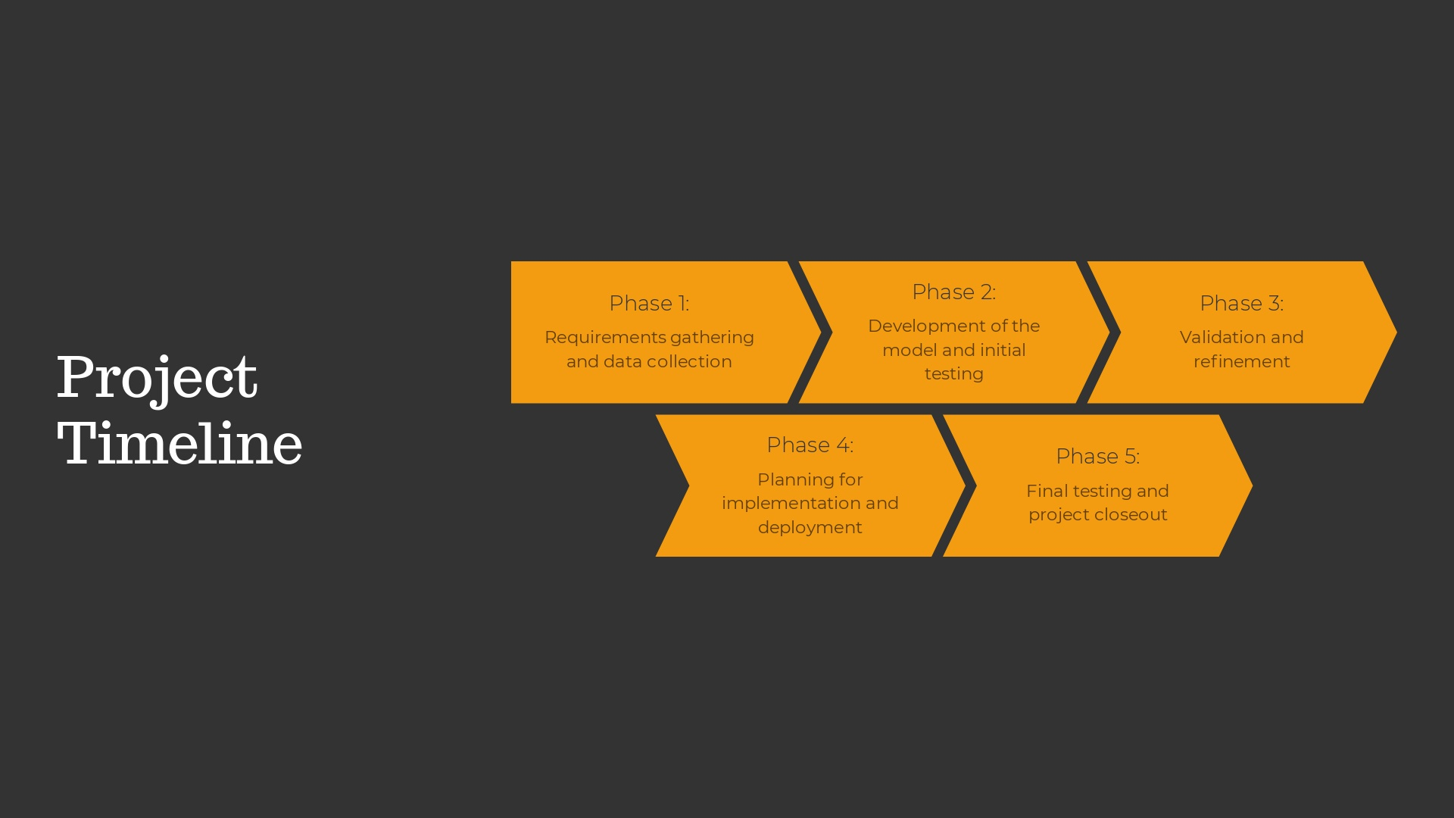

Slide 7
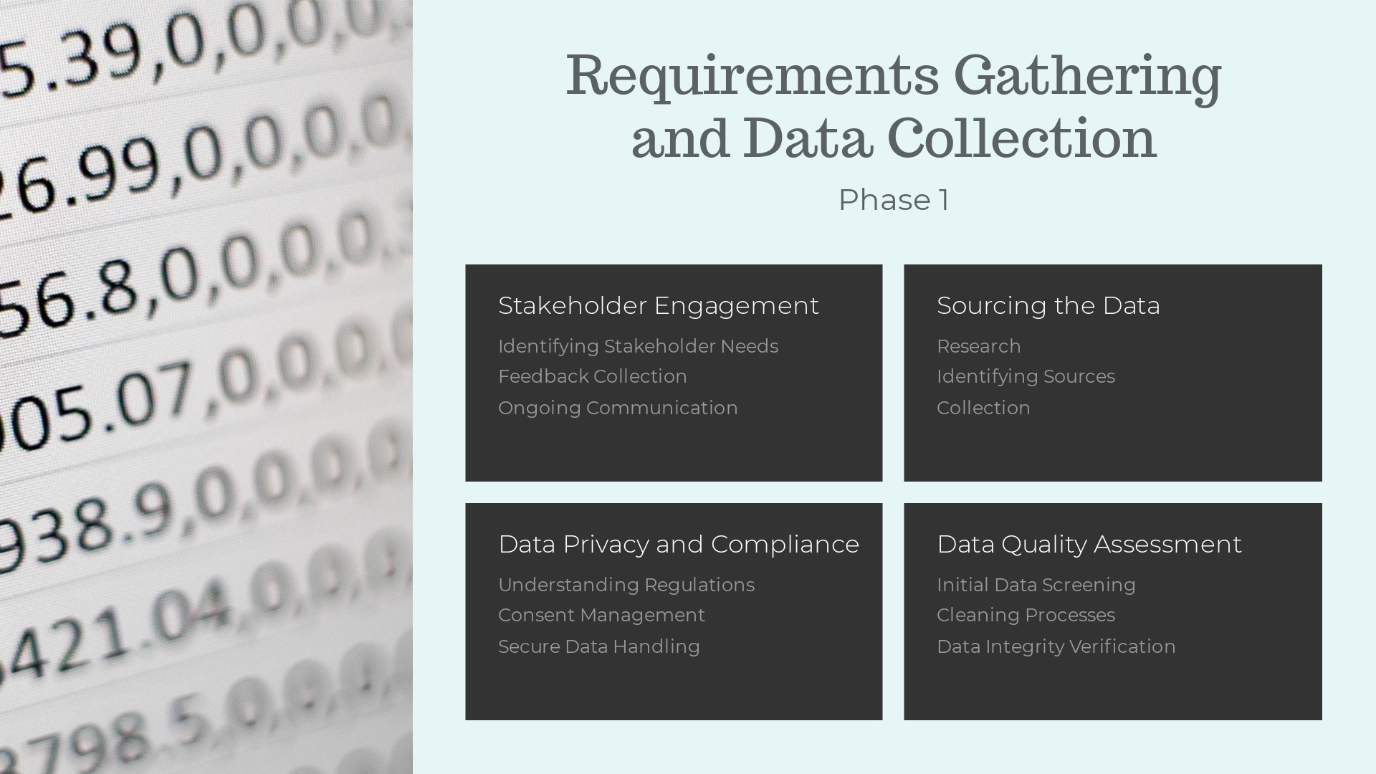

Slide 8
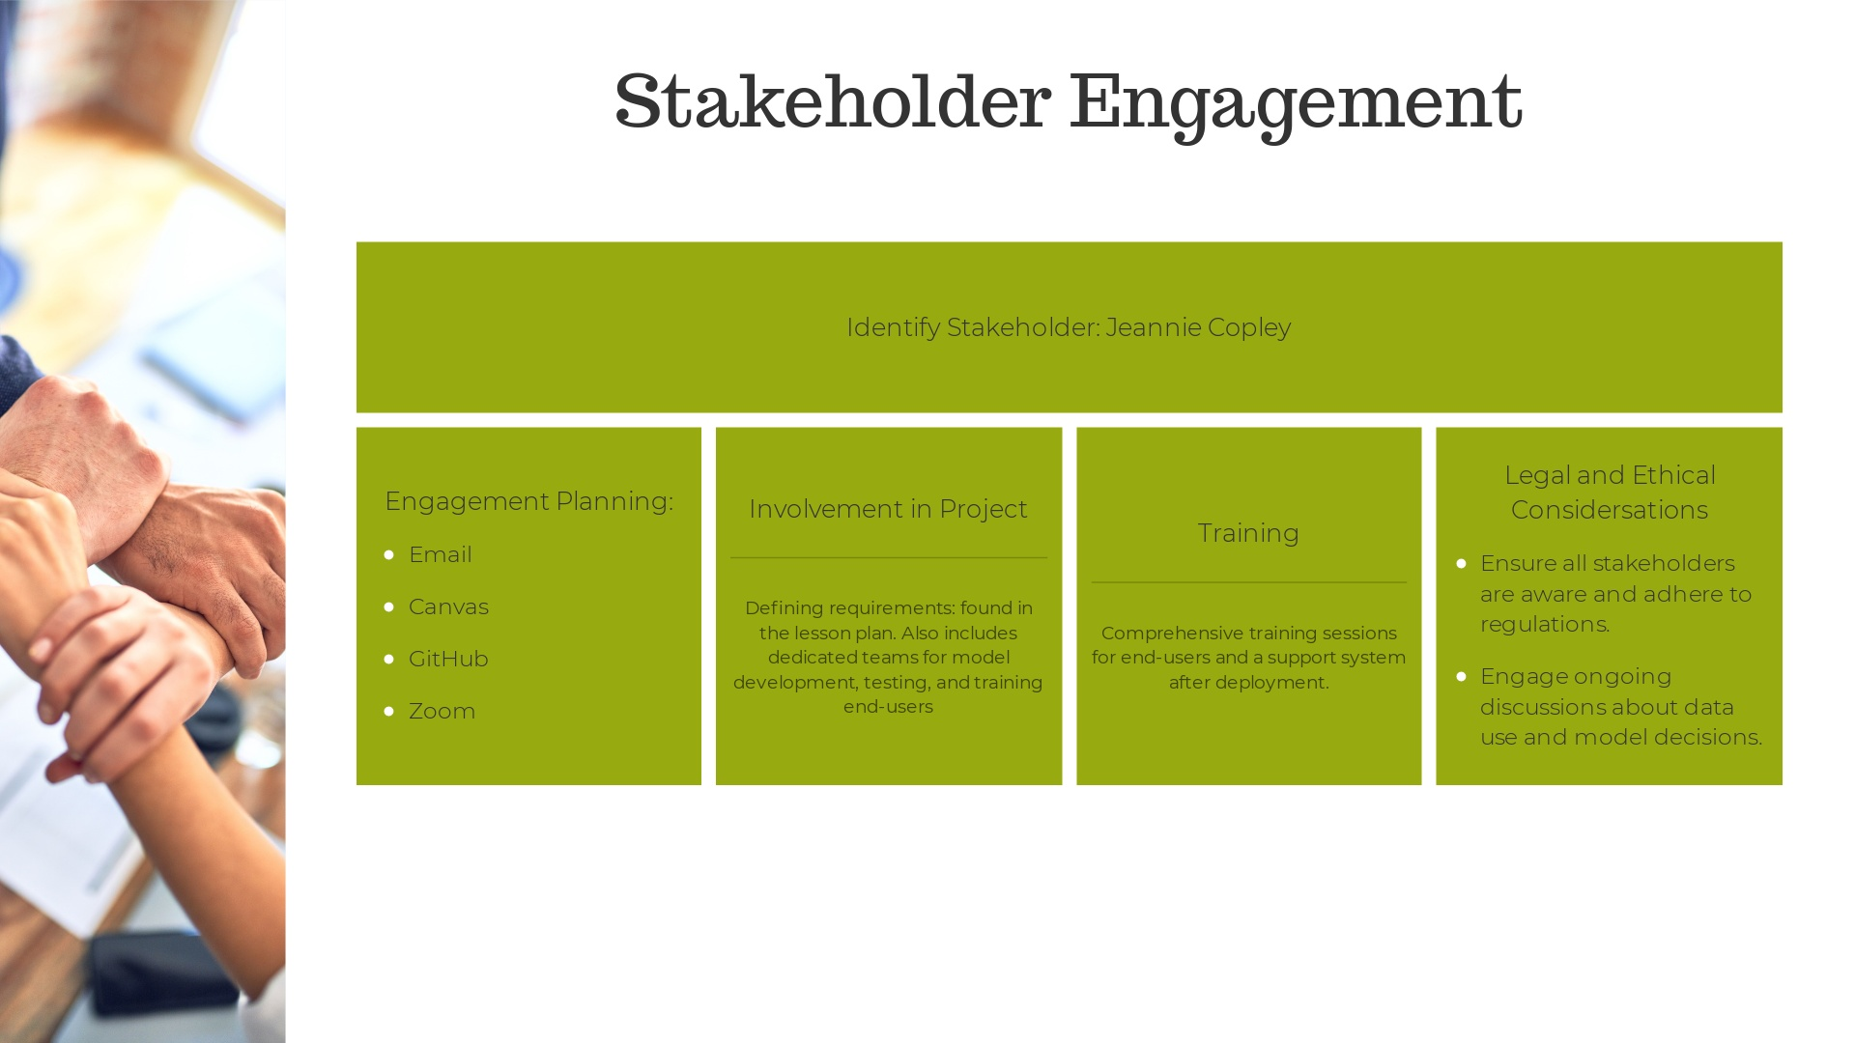
Notes:
1. Identification of Stakeholders a. Identify All Relevant Stakeholders: This includes anyone who has a stake in the project's outcomes, such as healthcare providers, patients, IT staff, data scientists, project managers, and regulatory bodies. b. Understand Stakeholder Interests: Each stakeholder group may have different priorities and concerns. Understanding these helps tailor communication and address specific needs or objections. 2. Engagement Planning a. Develop a Communication Plan: Establish a clear plan for how and when stakeholders will be updated on project progress. This plan should include regular meetings, updates, and checkpoints with different stakeholder groups. b. Feedback Mechanisms: Implement structured processes for stakeholders to provide feedback on project plans, progress, and preliminary findings. This could include surveys, focus groups, and review meetings. 3. Involvement in Project Phases a. Requirement Gathering: Involve stakeholders in defining the requirements of the predictive model. This includes understanding what outcomes are valuable to each stakeholder and any constraints (such as data privacy concerns) that need to be considered. b. Model Development and Testing: Engage technical stakeholders (like data scientists and IT staff) in the model development phase. Healthcare providers can offer insights into practical aspects and usability of the model. c. Pilot and Deployment: Involve end-users in the pilot testing of the model to gather feedback on its functionality and effectiveness in a real-world setting. This helps in fine-tuning the model before full-scale deployment. 4. Training and Support a. Provide Training: Offer comprehensive training sessions for end-users, such as healthcare providers, to ensure they are comfortable using the model and understand its outputs. b. Ongoing Support: Establish a support system to help stakeholders after deployment, addressing any issues they encounter in using the model. 5. Building and Maintaining Trust a. Transparency: Maintain transparency about how data is used, how decisions are made in the model, and the measures taken to ensure data privacy and security. b. Manage Expectations: Clearly communicate what the model can and cannot do to avoid unrealistic expectations. c. Demonstrate Value: Regularly show how the predictive model helps improve outcomes, such as through case studies or performance reports, to keep stakeholders engaged and supportive. 6. Legal and Ethical Considerations a. Regulatory Compliance: Ensure that all stakeholders are aware of and adhere to relevant regulations such as HIPAA or GDPR. b. Ethical Use of Data: Engage stakeholders in discussions about the ethical implications of data use, model decisions, and ensure the model does not propagate bias or unfairness.

Slide 9
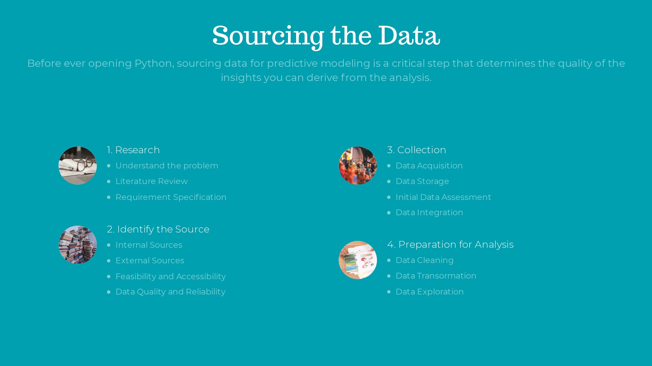
Notes:
1. Research: · Understanding the Problem: Begin by clearly defining the research question or problem statement. This understanding guides the type of data you need. · Literature Review: Review existing research and case studies to understand how similar problems have been addressed. This can provide insights into potential data sources and relevant variables that have proven useful. · Requirement Specification: Determine the specific data requirements such as the volume, variety, velocity, and veracity needed to address the problem effectively. 2. Identifying the Source: · Internal Sources: Check if the organization already has the data you need. Internal databases, CRM systems, transaction logs, and other operational data can be valuable. · External Sources: If internal data is insufficient, identify external sources. This can include public data sets, commercial data providers, online repositories, and governmental databases. · Feasibility and Accessibility: Assess the feasibility of accessing these sources. Consider legal, ethical, and financial constraints that might limit data availability. · Data Quality and Reliability: Evaluate the credibility of the data source. Ensure that the data is accurate, reliable, and comes from a reputable source. 3. Collection: · Data Acquisition: Based on the identified sources, acquire the data. This could involve downloading files, using APIs, scraping web data, or obtaining data through partnerships or purchases. · Data Storage: Ensure that you have the infrastructure to store the data securely and in compliance with any relevant regulations (such as GDPR or HIPAA). · Initial Data Assessment: Perform an initial assessment to check data integrity, completeness, and cleanliness. Identify any obvious issues that could affect data quality. · Data Integration: If multiple sources are used, integrate the data into a coherent format. This may involve resolving issues like varying data schemas, duplicate records, and inconsistent data entries. 4. Preparation for Analysis: · Data Cleaning: Address issues identified during the initial assessment. Clean the data by handling missing values, removing duplicates, and correcting errors. · Data Transformation: Transform the data into a format suitable for modeling. This may include normalizing data, encoding categorical variables, and creating derived variables. · Data Exploration: Conduct exploratory data analysis (EDA) to understand the data’s underlying structure, identify patterns, and spot anomalies.

Slide 10
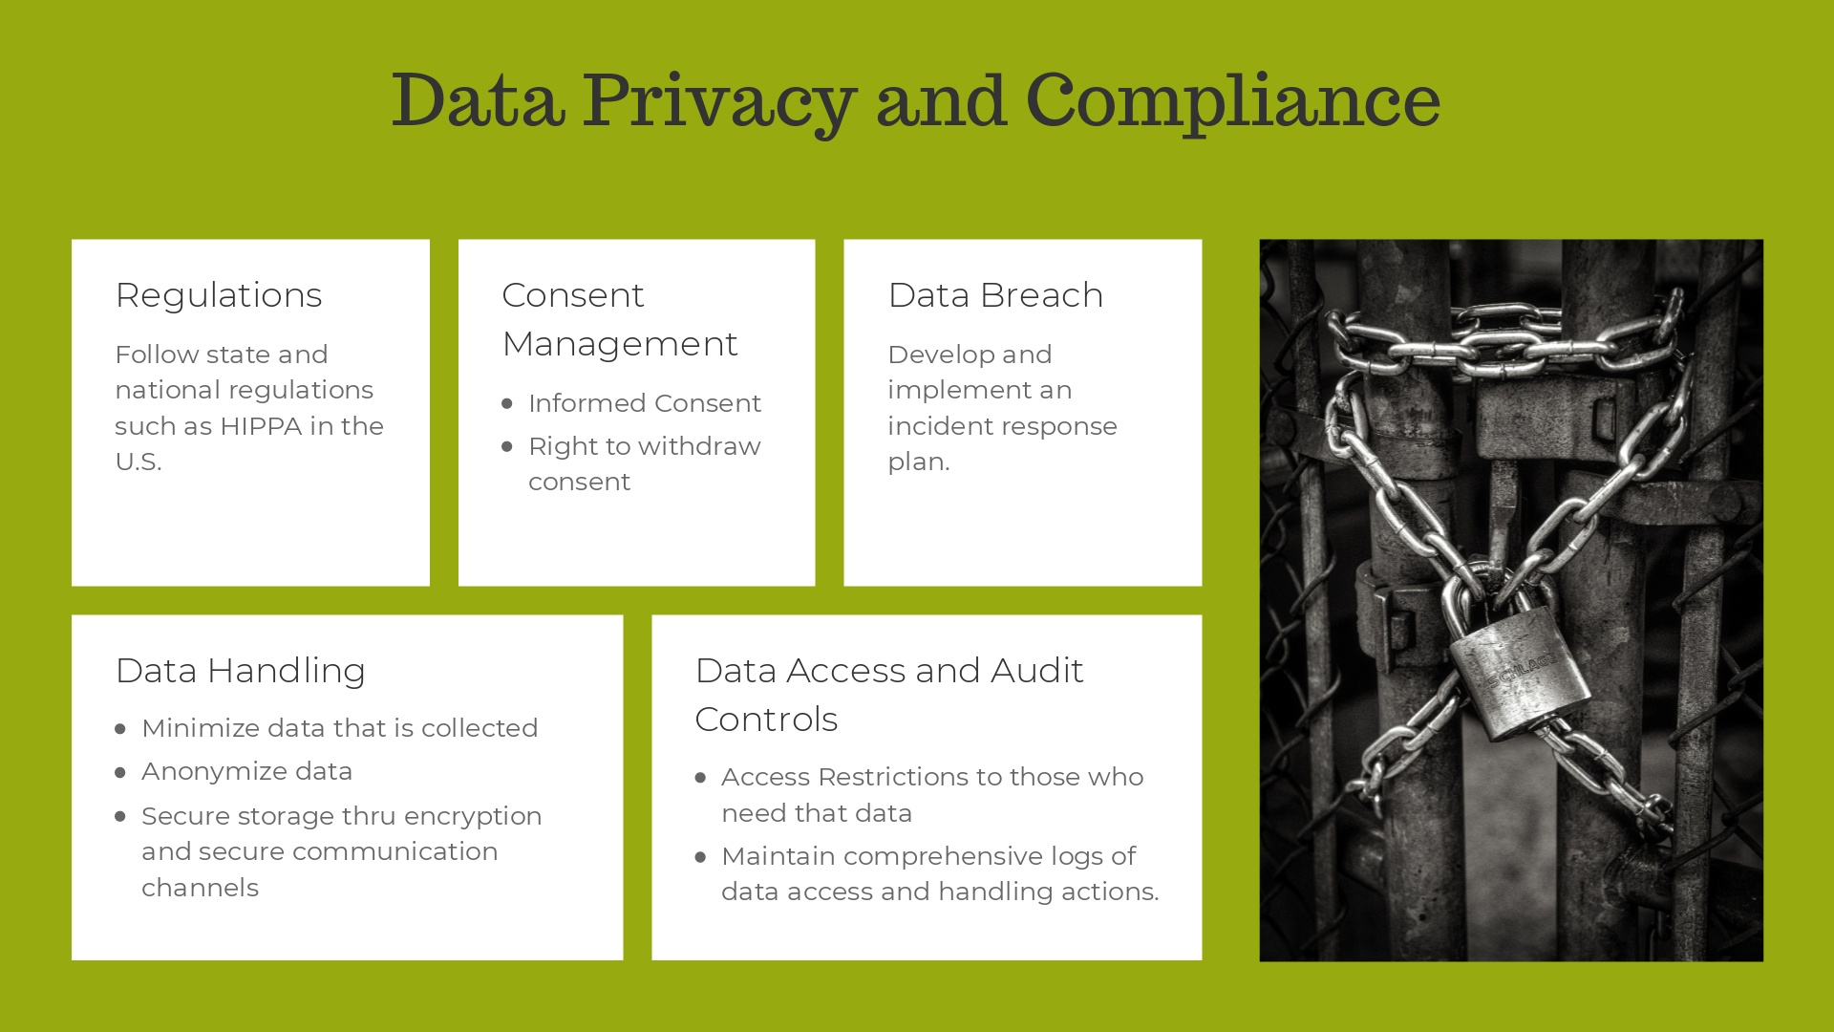
Notes:
1. Regulatory Compliance:· Health Insurance Portability and Accountability Act (HIPAA) in the U.S.: Ensures the protection of patient data, requiring safeguards to protect privacy and sets limits and conditions on the uses and disclosures that may be made of such information without patient authorization.2. Data Handling Policies:· Data Minimization: Collect only the data that is directly relevant and necessary to accomplish the specified purpose.· Purpose Limitation: Use the data only for the specific purposes for which it was collected.· Data , secure data storage solutions, and secure communication channels to protect data during storage and transit.3. Consent Management:· Informed Consent: Ensure that consent is obtained from all data subjects for the use of Consent: Provide mechanisms for individuals to withdraw consent at any time, respecting their legal rights under applicable privacy laws.4. Data Access and Audit Controls:· Access Restrictions: Restrict data access to only those individuals who need it for the purpose of the project, implementing role-based access controls.· Audit Trails: Maintain comprehensive logs of data access and handling actions to provide an audit trail that can be reviewed in case of compliance audits or security reviews.5. Data Breach Response Plan:· Incident Response: Develop and implement an incident response plan to address data breaches or data exposure incidents, including notification procedures as required by law.6. Ethical Considerations: · Bias and Fairness: Assess and address potential biases in the data and model outputs to ensure fairness and avoid discriminatory outcomes.

Slide 11
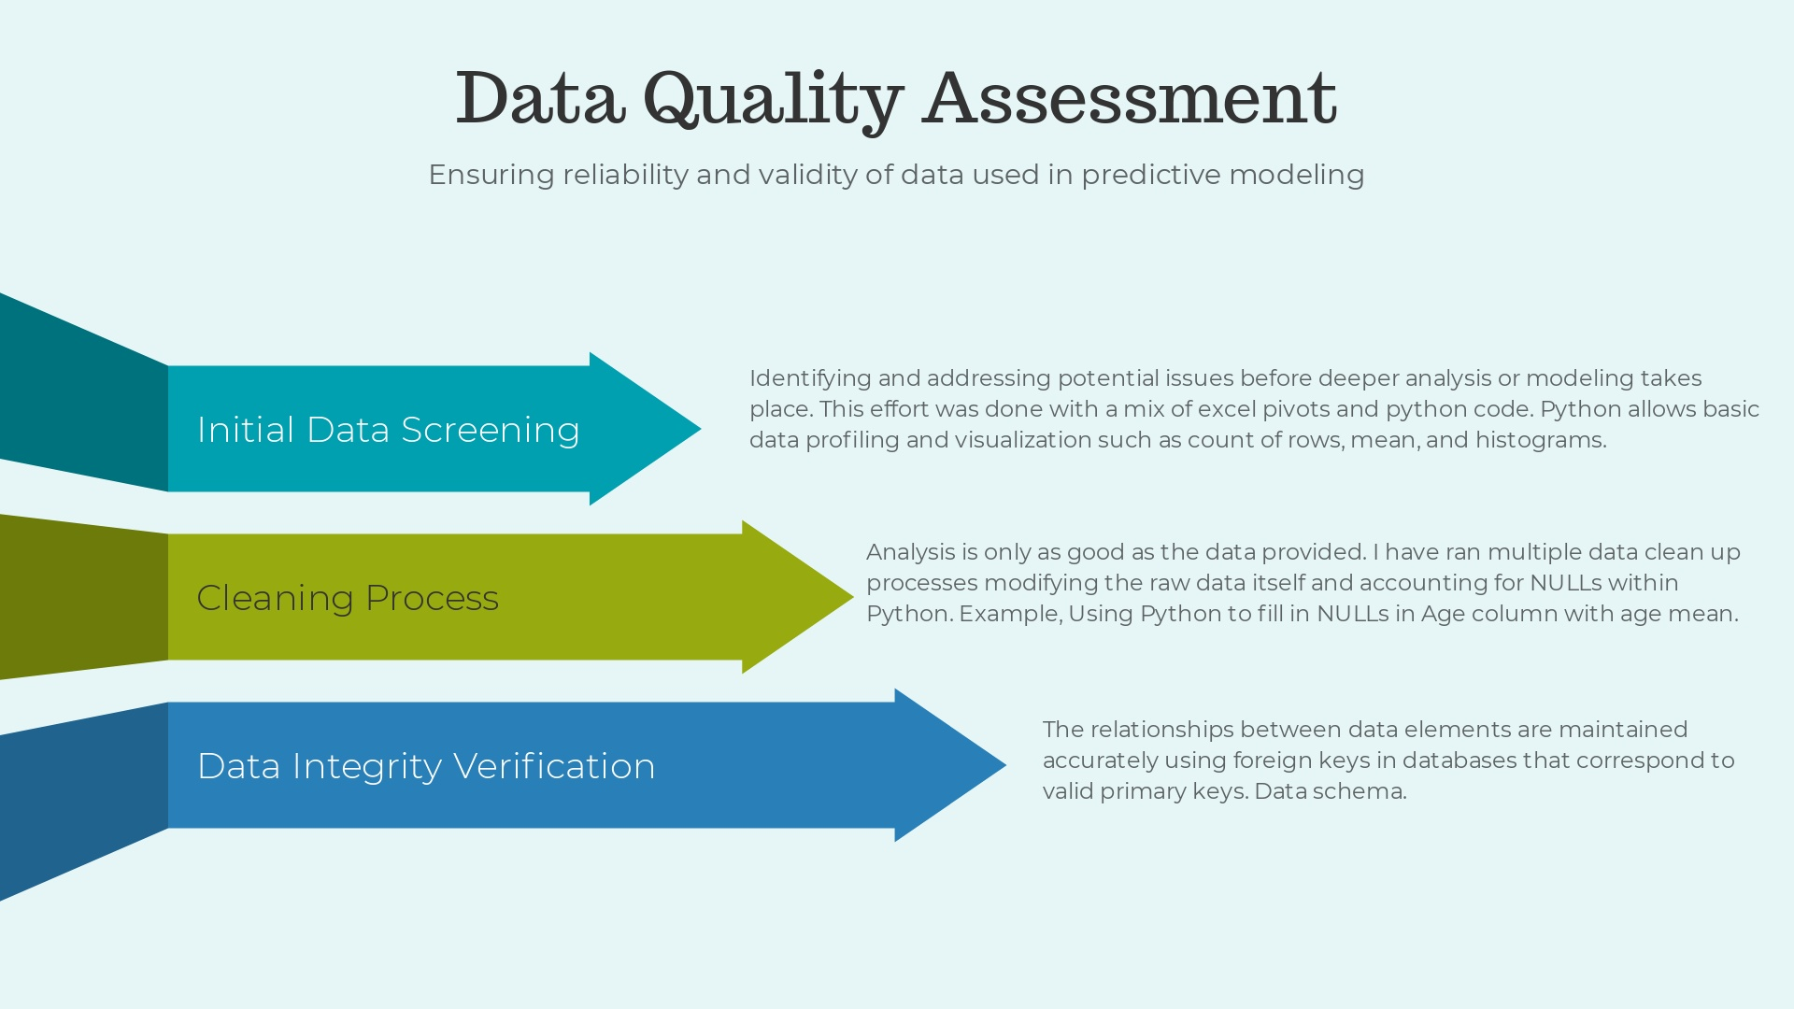
Notes:
I cleaned up Type of bill to remove leading zeros No procedure codes beyond 13 - Removing columns to enhance performance No diag codes beyond 27 - Removing columns to enhance performance I cleaned up data by removing any rows with missing DOB and Gender Primary key created on patient name for relationship connection and to remove connections to patients Primary key created on claim ID to remove claim identification from dataset I have 9 patients where the End Service Date is greater than the date of death. For this I have forced the DOD as the max date to avoid issues with the model

Slide 12
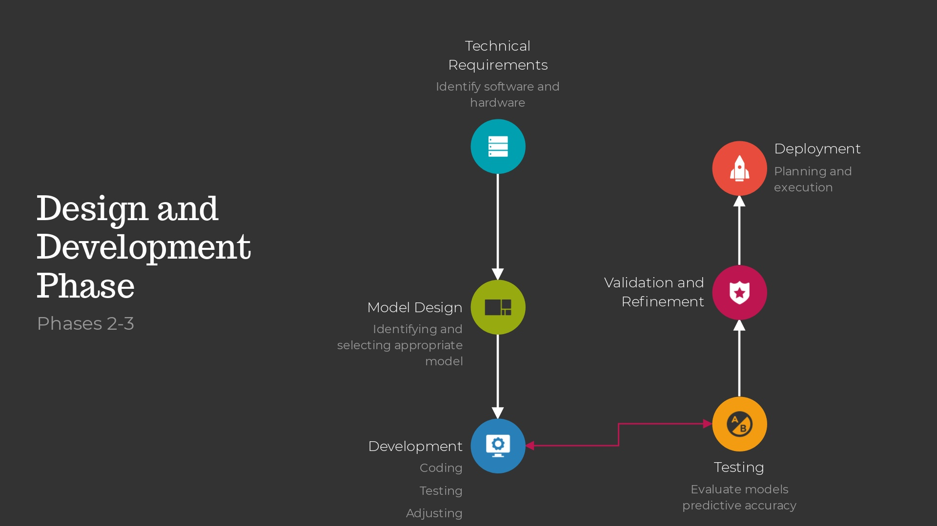

Slide 13
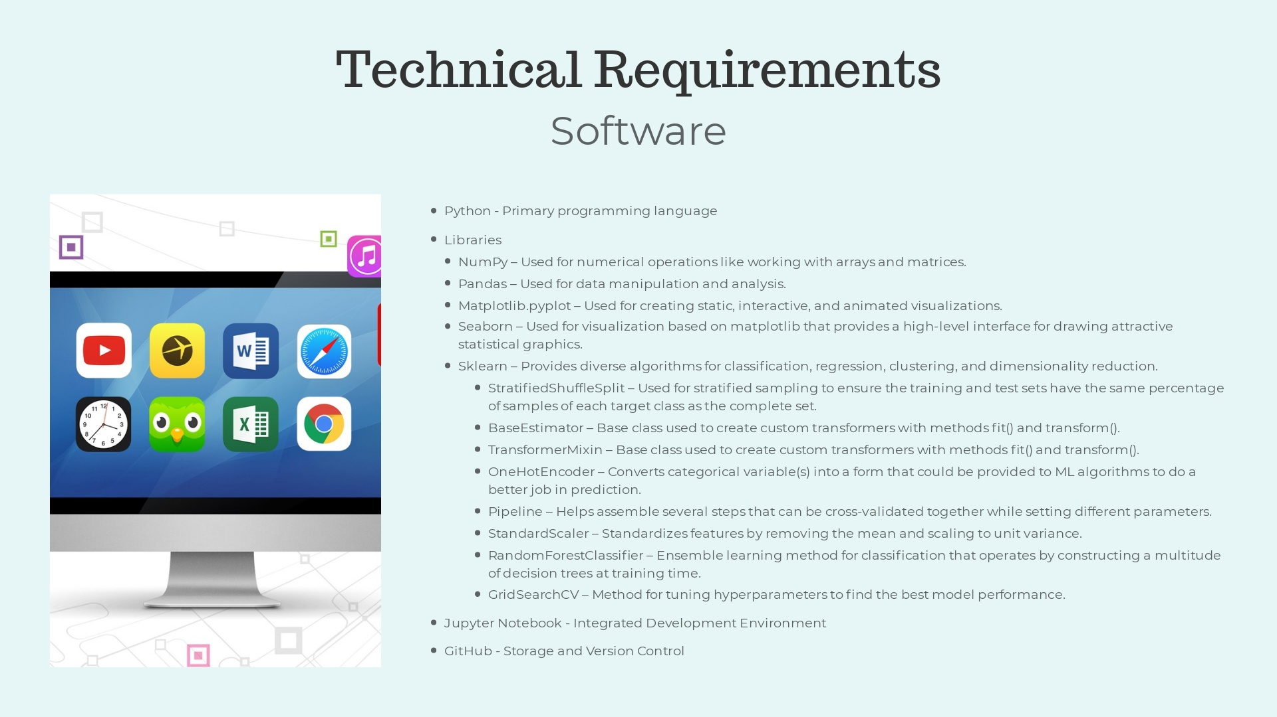
Notes:
Software Requirements at an Organizational Level: 1. Data Science and Machine Learning Platforms: · Use of platforms like Anaconda for managing Python environments and packages. · Adoption of machine learning platforms such as TensorFlow, PyTorch, or Microsoft Azure Machine Learning for more complex model development and training. 2. Advanced Analytical Tools: · Integration of advanced analytics software like SAS, SPSS, or R for specialized statistical analysis. · Utilization of big data platforms like Apache Hadoop or Spark for processing large datasets. 3. Collaboration and Version Control Systems: · Implementation of version control systems like Git, SVN, or Mercurial integrated with platforms like GitHub, GitLab, or Bitbucket for code sharing and collaboration. · Deployment of project management and collaboration tools such as Jira, Confluence, or Trello to enhance team coordination. 4. Database Management Systems: · Use of SQL databases like MySQL, PostgreSQL, or cloud-based solutions like Amazon RDS for structured data management. · Incorporation of NoSQL databases such as MongoDB, Cassandra, or Redis for unstructured data or where high read/write speeds are required.

Slide 14

Notes:
1. Servers: · Deployment of robust server infrastructure to handle computation and storage demands. This includes dedicated servers for data processing and machine learning tasks. · High-performance servers with multi-core processors (e.g., Xeon, AMD EPYC) and extensive memory capacity (64GB or more) to facilitate intensive computational tasks like model training and data processing. 2. Virtual Desktop Infrastructure (VDI): · Implementation of virtual desktops to provide remote access to powerful computing resources. This helps in managing software environments more efficiently and enhances security by centralizing data. · Use of VDI solutions like VMware Horizon or Citrix for scalable access to desktops with the necessary analytical tools and environments. 3. Storage Solutions: · High-speed storage systems, preferably SSD-based, for fast data retrieval and processing. This is crucial for performance in real-time analytics. · Deployment of scalable storage solutions like NAS or SAN for centralized data storage that can grow with the organization's needs. 4. Network Infrastructure: · Robust internal network infrastructure with high-speed connectivity to support data transfer requirements between servers, storage solutions, and end-users’ virtual desktops. · Adequate internet bandwidth and secure network configurations to support cloud-based data operations and remote computing. 5. Cloud Computing Resources: · Leveraging cloud platforms (AWS, Azure, Google Cloud) for scalable computing resources. This can include the use of cloud-based machine learning services, serverless computing, and auto-scaling capabilities. · Implementation of hybrid cloud environments to balance between on-premises capabilities and cloud scalability, especially for sensitive data or specific compliance requirements. 6. Security and Compliance: · Enhanced security measures including firewalls, intrusion detection systems, and regular security audits to protect sensitive data. Compliance with relevant data protection regulations (GDPR, HIPAA) through secure data handling practices and infrastructure.

Slide 15
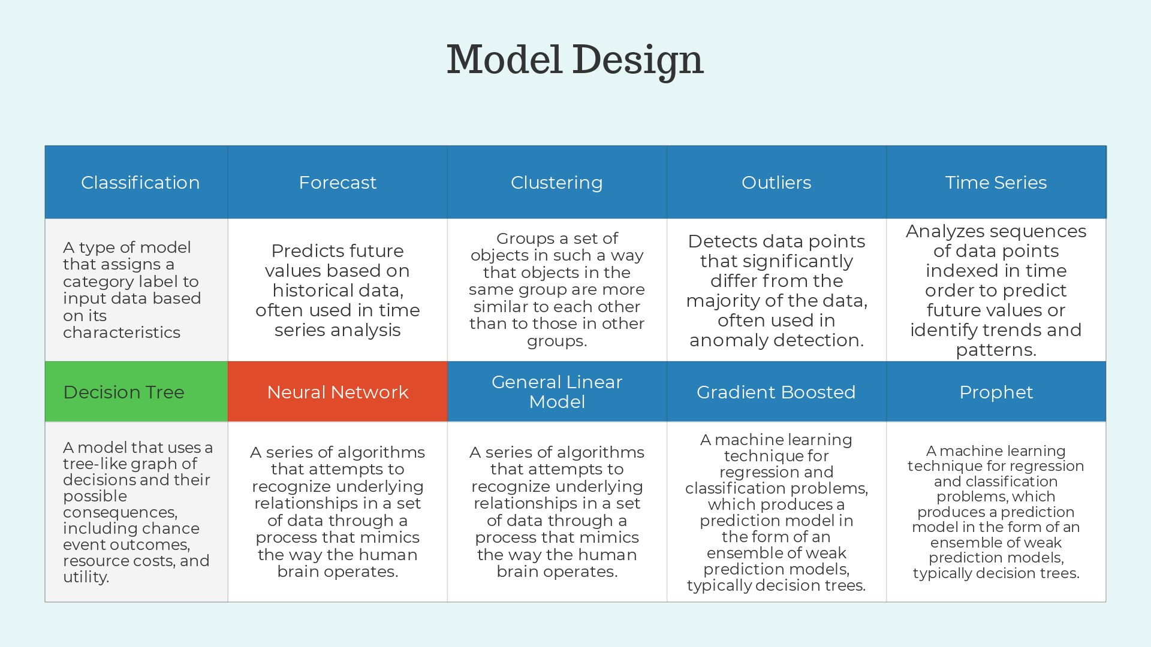
Notes:
1. Classification: A type of model that assigns a category label to input data based on its characteristics. 2. Forecast: Predicts future values based on historical data, often used in time series analysis. 3. Clustering: Groups a set of objects in such a way that objects in the same group are more similar to each other than to those in other groups. 4. Outliers: Detects data points that significantly differ from the majority of the data, often used in anomaly detection. 5. Time Series: Analyzes sequences of data points indexed in time order to predict future values or identify trends and patterns. 6. Decision Tree: A model that uses a tree-like graph of decisions and their possible consequences, including chance event outcomes, resource costs, and utility.*Note: This is the model used for this project. The class Random Forest Classifier is what classifies this model as a decision tree. 7. Neural Network: A series of algorithms that attempts to recognize underlying relationships in a set of data through a process that mimics the way the human brain operates.*Note: This model would be the best for this project due to its efficiency in using large amounts of data and how it handles complex relationships. 8. General Linear Model (GLM): Provides a general framework for regression that encompasses several traditional models like linear regression and logistic regression. 9. Gradient Boosted: A machine learning technique for regression and classification problems, which produces a prediction model in the form of an ensemble of weak prediction models, typically decision trees. 10. Prophet: A procedure for forecasting time series data based on an additive model where non-linear trends are fit with yearly, weekly, and daily seasonality, plus holiday effects.

Slide 16
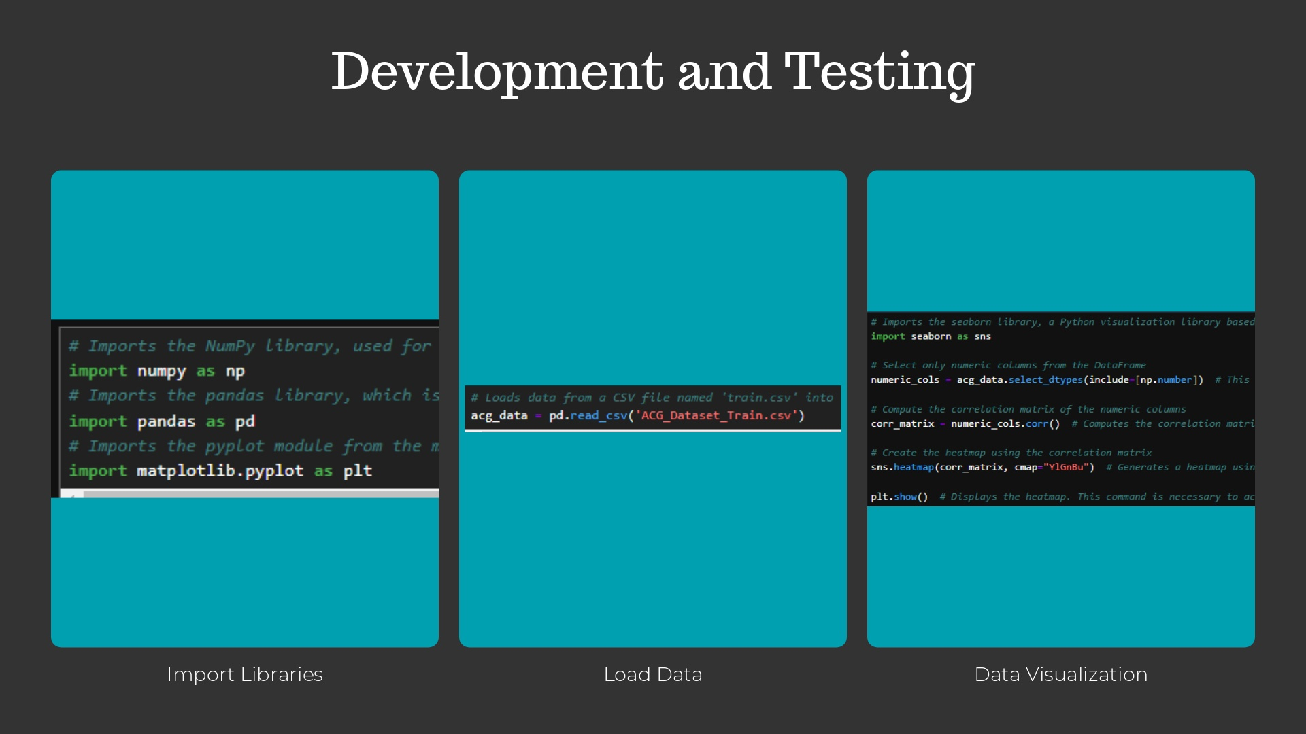
Notes:
1. Import Libraries · Libraries such as NumPy, pandas, matplotlib.pyplot, and seaborn are imported for data manipulation, numerical operations, and visualization. 2. Load Data · The ACG dataset is loaded from a CSV file into a pandas DataFrame for analysis. 3. Data Visualization · A correlation matrix of numeric columns is calculated and visualized using a heatmap. This helps in understanding the relationships between different numerical variables.

Slide 17
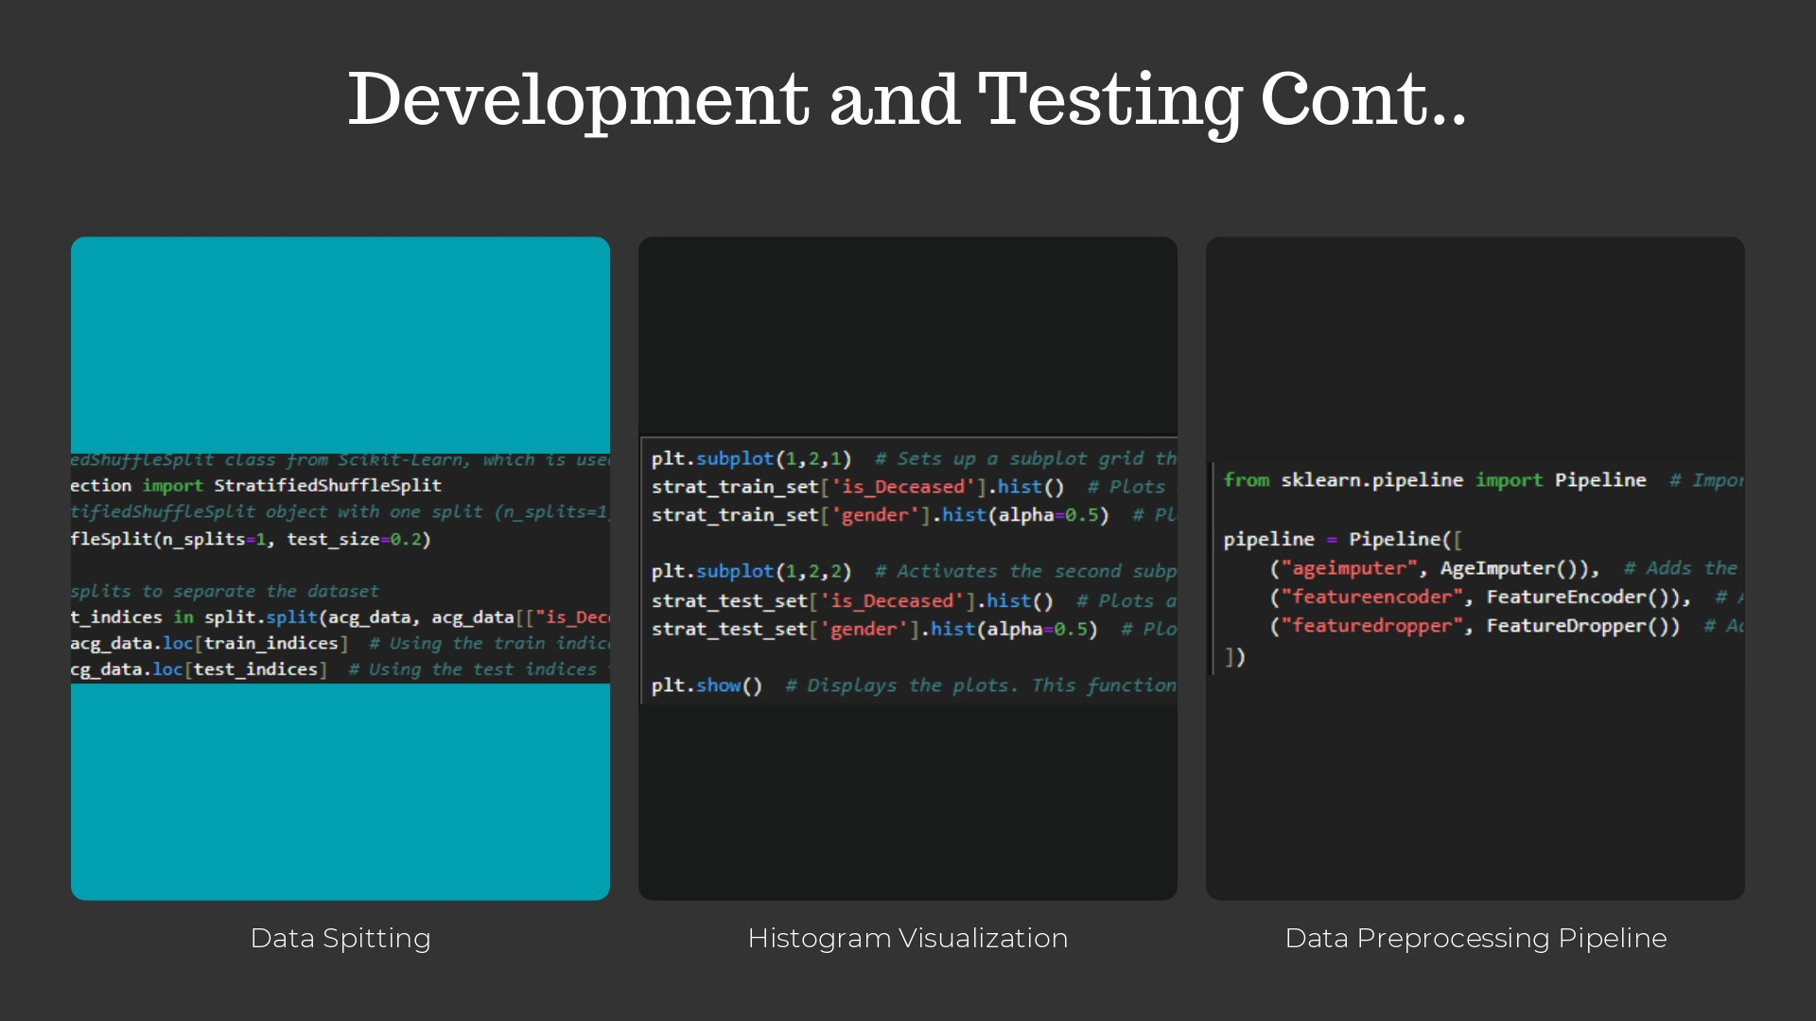
Notes:
4. Data Splitting · The dataset is split into training and testing sets using StratifiedShuffleSplit, ensuring that both sets are representative of the overall dataset, particularly maintaining the same proportion of target classes. 5. Histogram Visualization · Histograms are created for ‘is_deceased’ and 'gender' columns in both the training and testing sets to visualize the distribution of these variables. 6. Data Preprocessing Pipeline · A preprocessing pipeline is set up using scikit-learn's Pipeline class, including steps for imputing missing values in the 'Age' column, encoding categorical features like 'Provider Specialty', 'dxcd1' and 'gender', and dropping unnecessary columns.

Slide 18
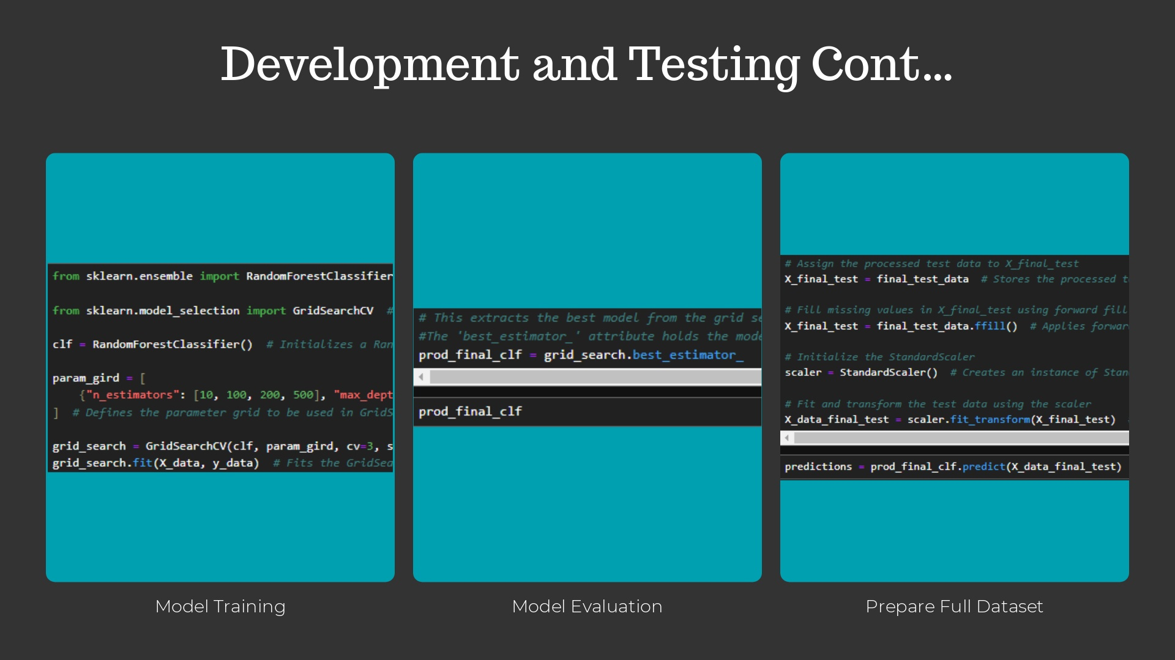
Notes:
7. Model Training · A RandomForestClassifier is initialized, and its hyperparameters are optimized using GridSearchCV. This involves setting up various combinations of parameters and selecting the best model based on accuracy. 8. Model Evaluation · The performance of the best model from GridSearchCV is evaluated on a separate test dataset using accuracy as the metric. 9. Prepare Full Dataset The preprocessing transformations are applied to the entire dataset, which is useful for final model training or obtaining a transformed dataset for other uses.

Slide 19
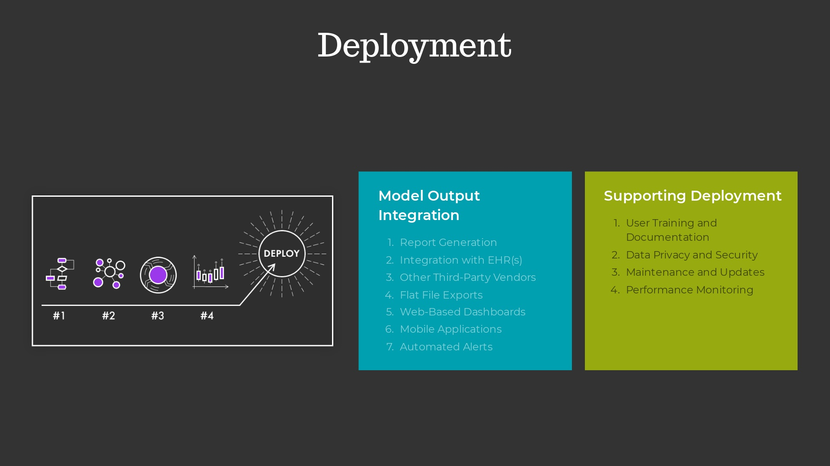
Notes:
1. Model Output Integrationa. Report Generation: Develop a system that automatically generates reports from the model’s predictions. These reports should translate the model's outputs into easily interpretable information, such as risk scores or predictive alerts, that healthcare providers can understand and act upon.b. Integration with Electronic Health Records (EHR): Embed the reports into the EHR system used by the healthcare providers. This can be done by developing plugins or extensions that pull predictive outputs into the EHR interface, where clinicians most frequently access patient information.c. Third-Party Vendor Systems: Collaborate with vendors that healthcare facilities already use for analytics or data management. These systems can be used to generate and deliver predictive reports, ensuring that they align with existing workflows.d. Flat File Exports: Provide the option to export reports as flat files (e.g., CSV, PDF) that can be easily distributed and opened on various systems. This is particularly useful for smaller clinics or facilities with less sophisticated IT infrastructure.2. Additional Deployment Strategiesa. Web-Based Dashboards: Develop interactive dashboards that can be accessed securely online or through intranet systems. These dashboards can provide real-time predictive insights and allow users to drill down into the data for more detailed analysis.b. Mobile Applications: Create mobile apps for tablets and smartphones that can deliver predictive reports directly to healthcare providers, allowing them to access insights on-the-go, especially useful in large facilities or for providers who work across multiple locations.c. Automated Alerts: Implement a system where critical predictive insights (such as high-risk patient alerts) are sent directly to providers via SMS, email, or through mobile push notifications. This ensures timely intervention without the need for providers to continually check for updates.3. Supporting Deployment Topicsa. User Training and Documentation: Even if the model's complexity is hidden behind user-friendly reports, providing training on how to interpret and act on these reports is crucial. Comprehensive documentation can assist in understanding the implications and limitations of the predictive insights.b. Data Privacy and Security: Ensure that all integrations comply with data protection regulations like HIPAA. Implement robust security measures to protect data integrity and confidentiality, especially when transmitting data across systems or accessing it through mobile and web applications.c. Maintenance and Updates: Establish procedures for regularly updating and maintaining the deployed model. This includes retraining the model on new data, updating integration points with EHRs or other systems, and refining the reporting mechanisms based on user feedback. d. Performance Monitoring: Continuously monitor the performance of the deployed model to ensure it remains accurate and relevant. Implement metrics to assess the impact of the model’s predictions on patient outcomes and adjust the model as healthcare practices and data landscapes evolve.

Slide 20
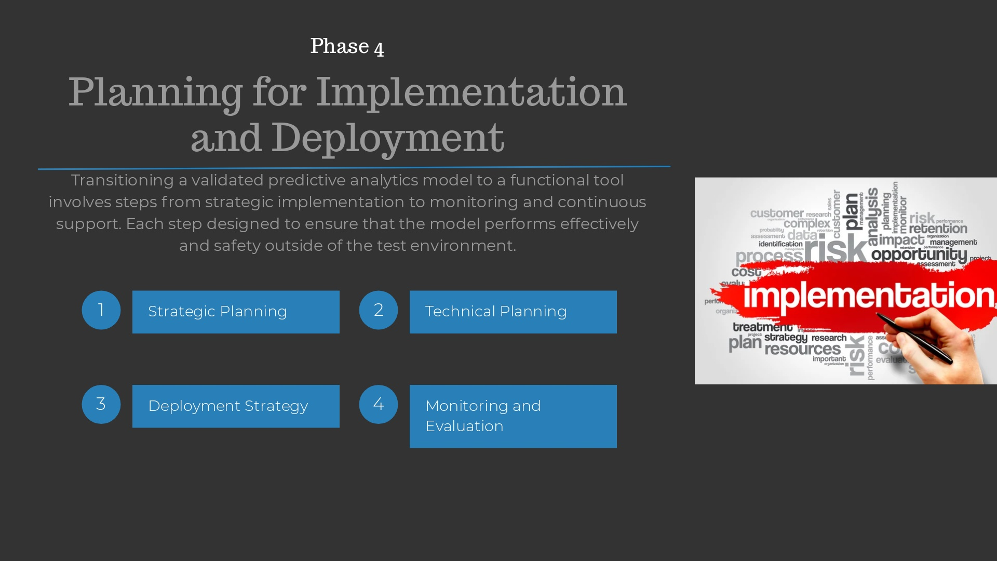

Slide 21
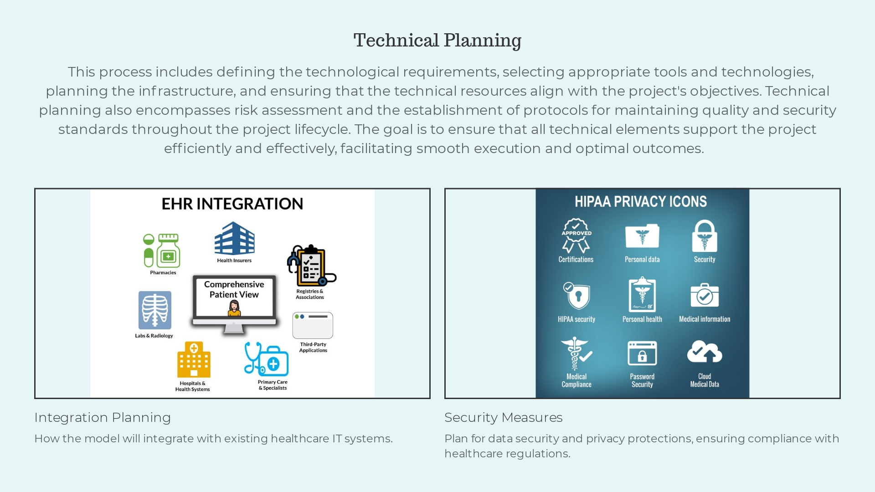

Slide 22
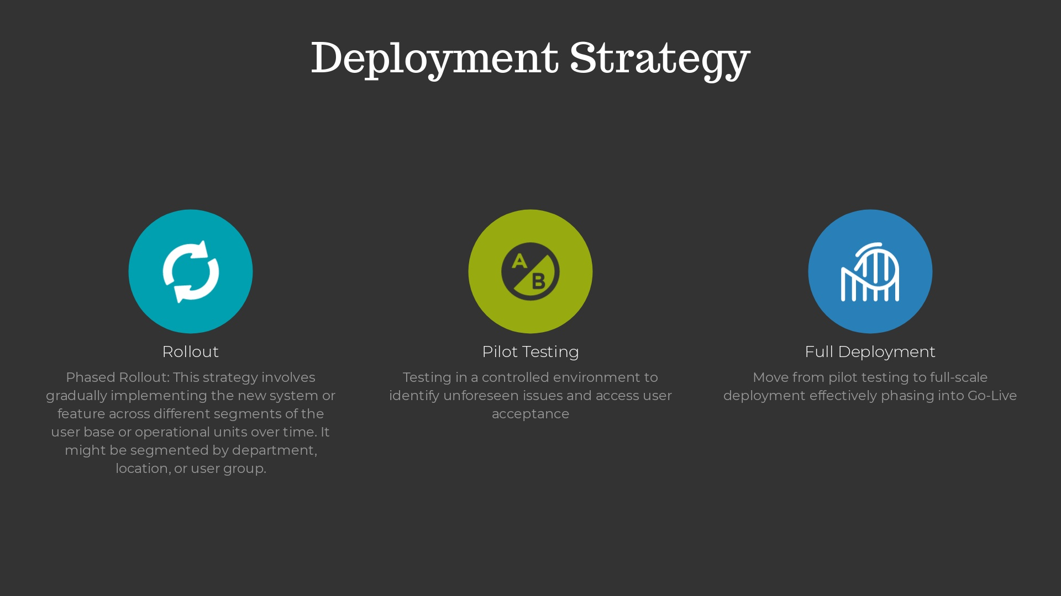
Notes:
1. Phased Rollout - This strategy involves gradually implementing the new system or feature across different segments of the user base or operational units over time. It might be segmented by department, location, or user group. Advantages: Minimizes risk by allowing for the adjustment of issues as they arise on a smaller scale before full deployment. It also provides an opportunity to gather user feedback and make improvements. 2. Big Bang Deployment - Unlike the phased approach, the big bang deployment strategy involves releasing the new system or feature to all users at the same time. Advantages: Simplicity in execution and immediate full transition can be beneficial if the new system doesn’t have high risks of major disruptions. 3. Canary Release - A canary release is a technique where the new feature or system is rolled out to a small subset of users initially. This group acts like the "canary in the coal mine," helping to detect any unforeseen issues before wider release. Advantages: Allows for real-world testing of the system’s performance and stability under actual operating conditions with minimal impact if something goes wrong. 4. Blue/Green Deployment - This strategy involves running two identical production environments, only one of which is live at any given time. The new version is deployed to the inactive environment where it can be fully tested. Once testing is complete, the traffic is switched from the old environment to the new one. Allows for instant rollback if issues arise, as the old environment remains ready to be reactivated. It also minimizes downtime during the switch. 5. Feature Flagging (Toggle) - This approach uses feature flags to enable or disable features in a system without deploying new code. This allows the feature to be tested among different user groups or turned off quickly in case of issues. Advantages: Provides high flexibility and control over who sees what features and when. It also facilitates A/B testing and gradual feature rollouts. 6. Shadow Deployment - Also known as "mirror deployment," this strategy involves deploying the new version alongside the old version without actually directing real users to it. The new version processes data in parallel to see how it behaves compared to the old version. Advantages: Allows developers to observe the new version in a live environment without impacting the actual user experience, which is great for performance testing under load. Each of these strategies has its advantages and can be chosen based on the criticality of the system, the tolerance for risk, and the nature of the user base or operational environment.

Slide 23
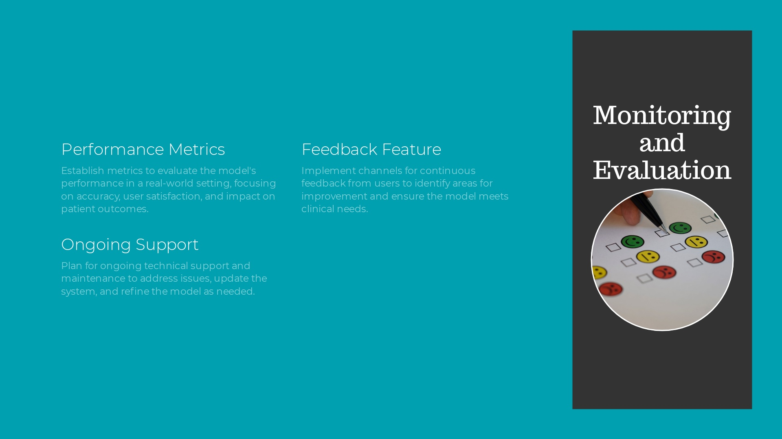

Slide 24
